Slide 1
Data Analytics With Tableau
Assignment-2
Name:-Katta Ramya
Registered No:20NN1A1291
College Name:-vignans Nirula Institute of technology and science for women

Slide 2
Task:- Upload the dataset to Tableau, delete the unnecessary columns Create below Visualization:
Donut Chart
Area Chart
Text Table
HighLighted Table
Word Cloud
Funnel Chart
Waterfall

Slide 3
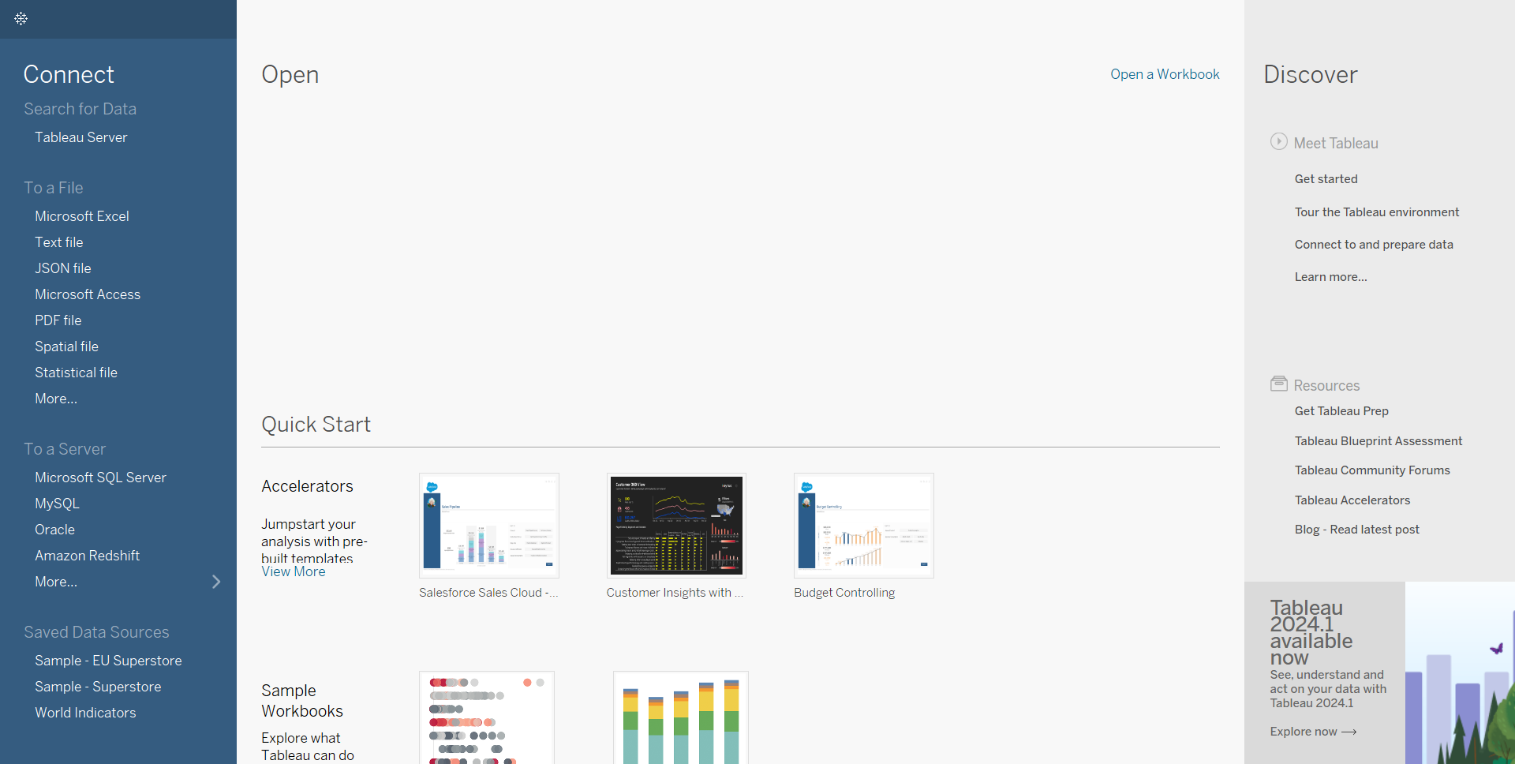
Tableau Starting:-

Slide 4
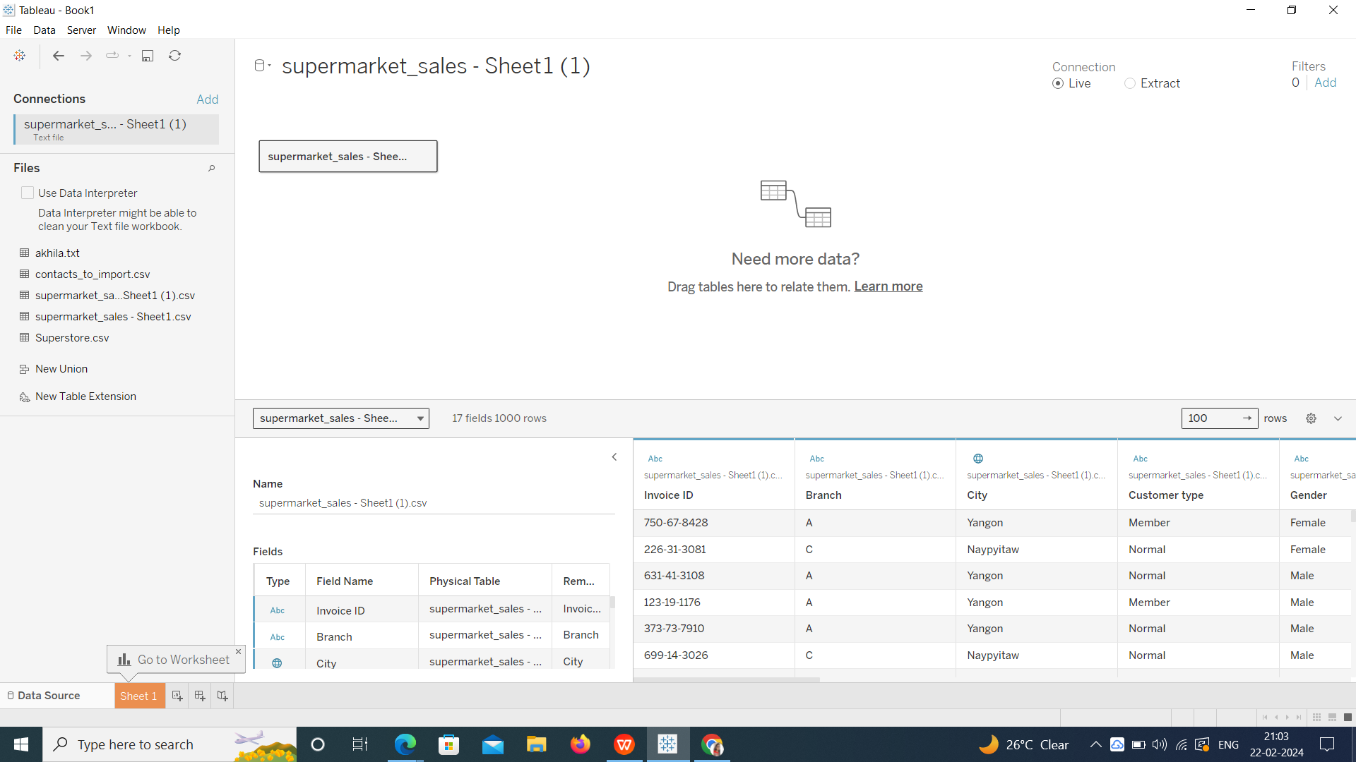
Upload the dataset to Tableau, delete the unnecessary columns:-

Slide 5
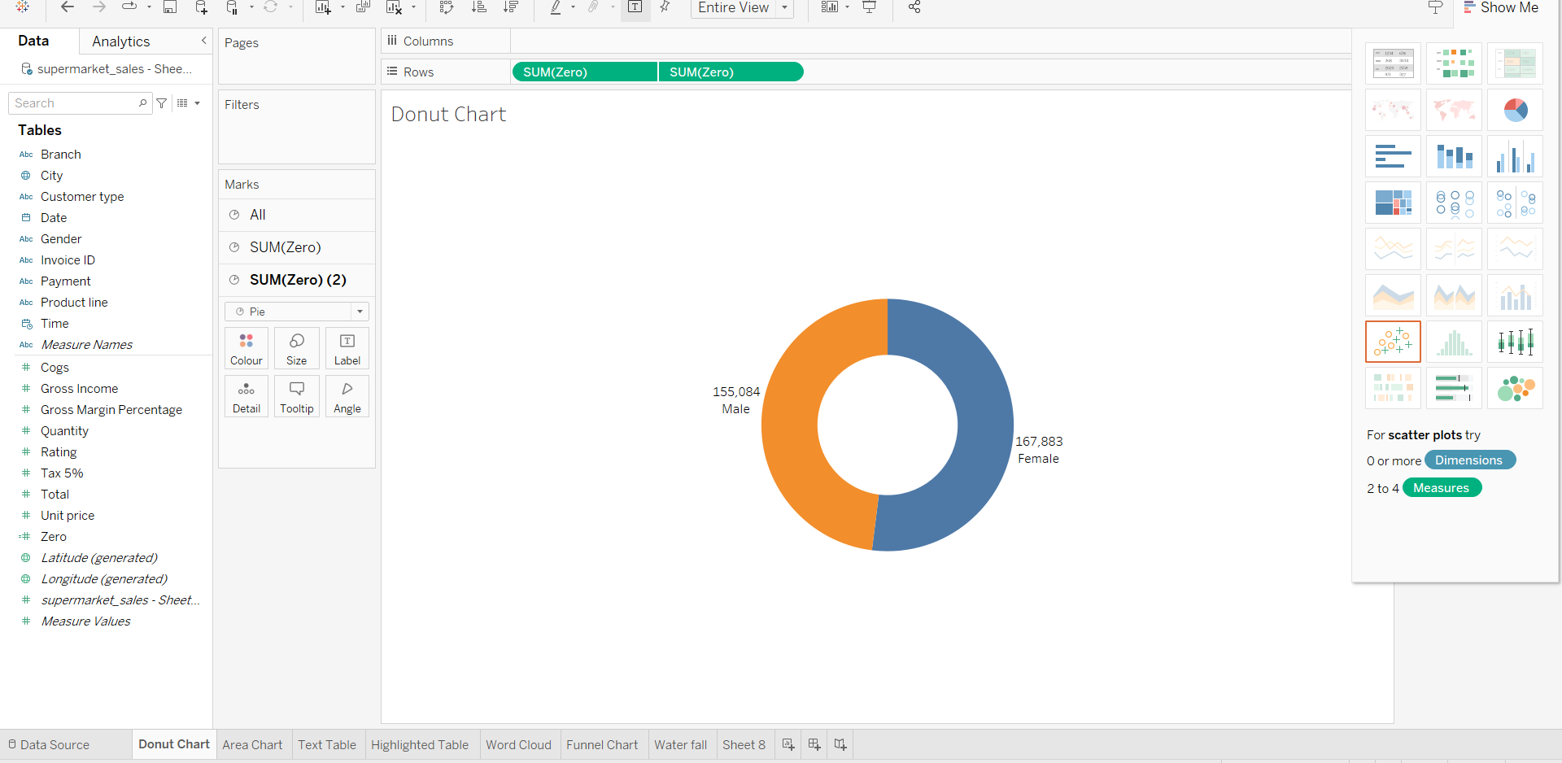
Create below Visualization: Donut Chart:-

Slide 6
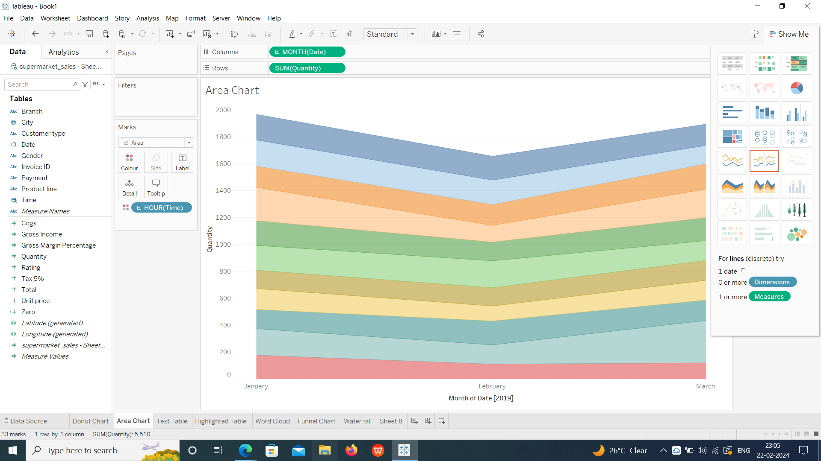
Area Chart:-

Slide 7
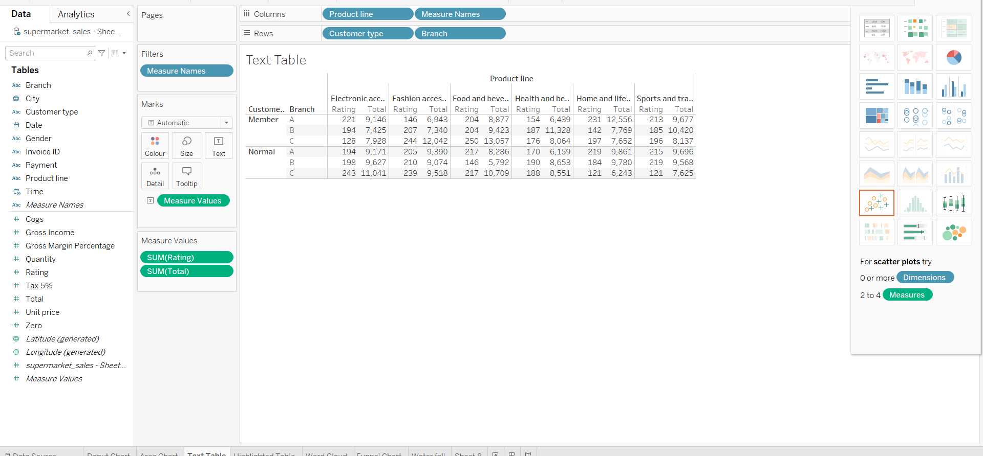
Text Table:-

Slide 8
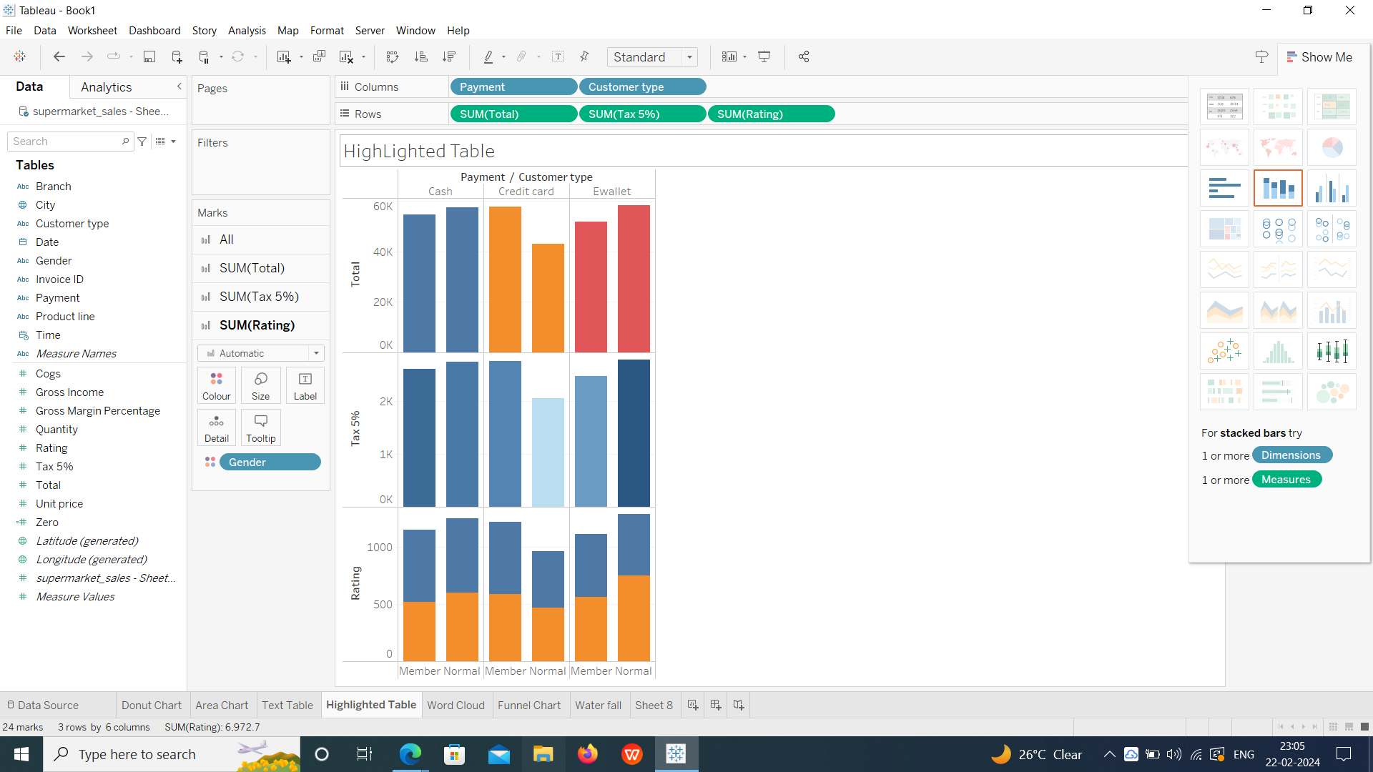
HighLighted Table:-

Slide 9
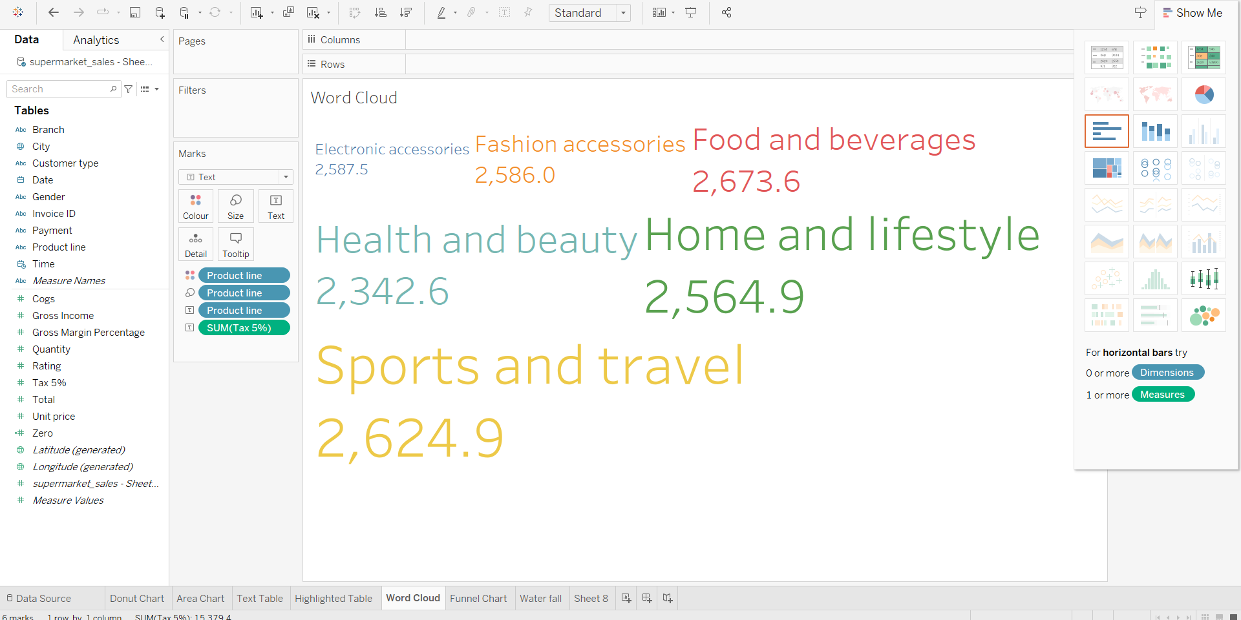
Word Cloud:-

Slide 10
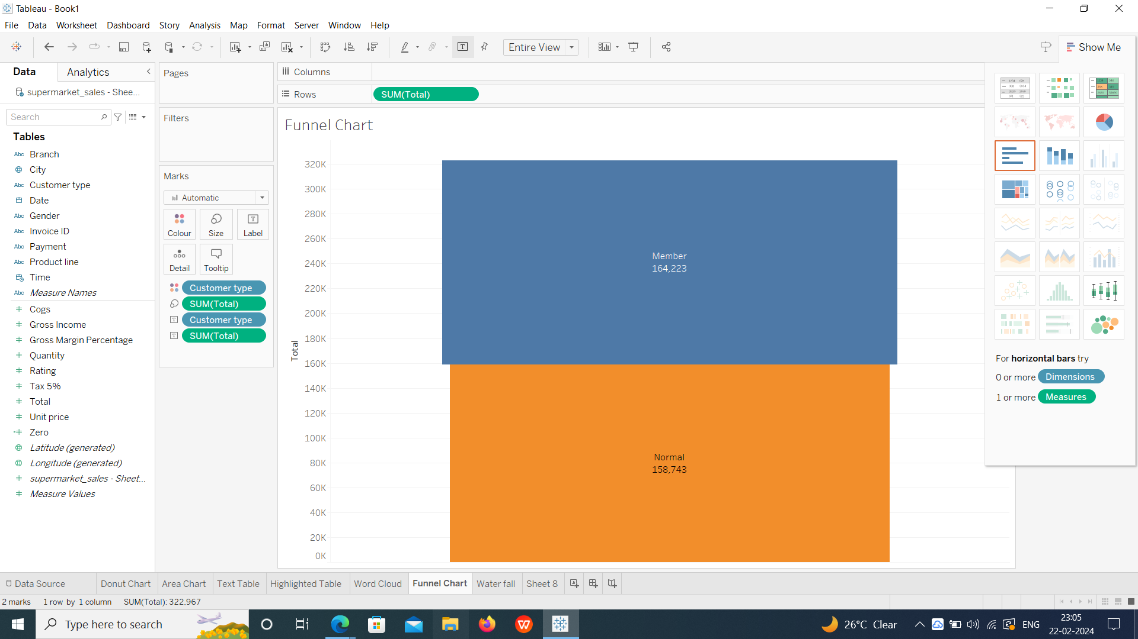
Funnel Chart:-

Slide 11
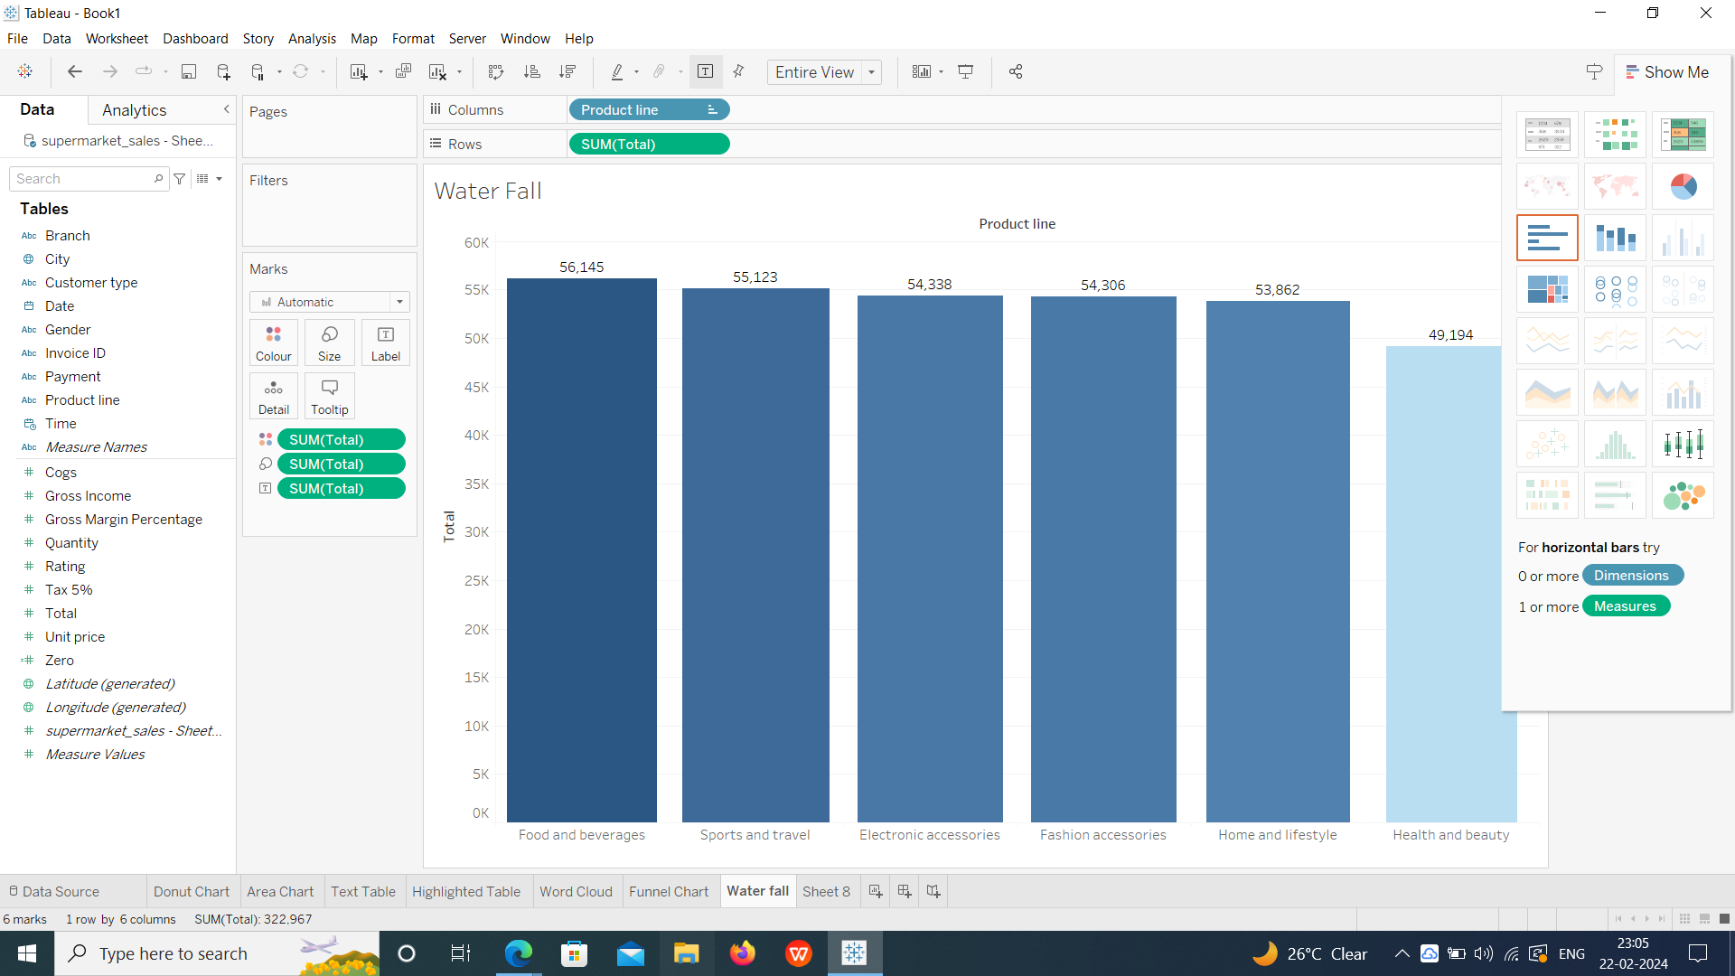
WaterFall:-

Slide 12
Thank you
Email:ramyaraokatta@gmail.com

